Slide 1
Computational Fluid Dynamics – ME 820 Computer Project #2
Daniel Franken

Slide 2
Problem Statement
Lid Driven Cavity
Staggered Mesh
Various Mesh Sizes
Various Reynolds Number

Slide 3
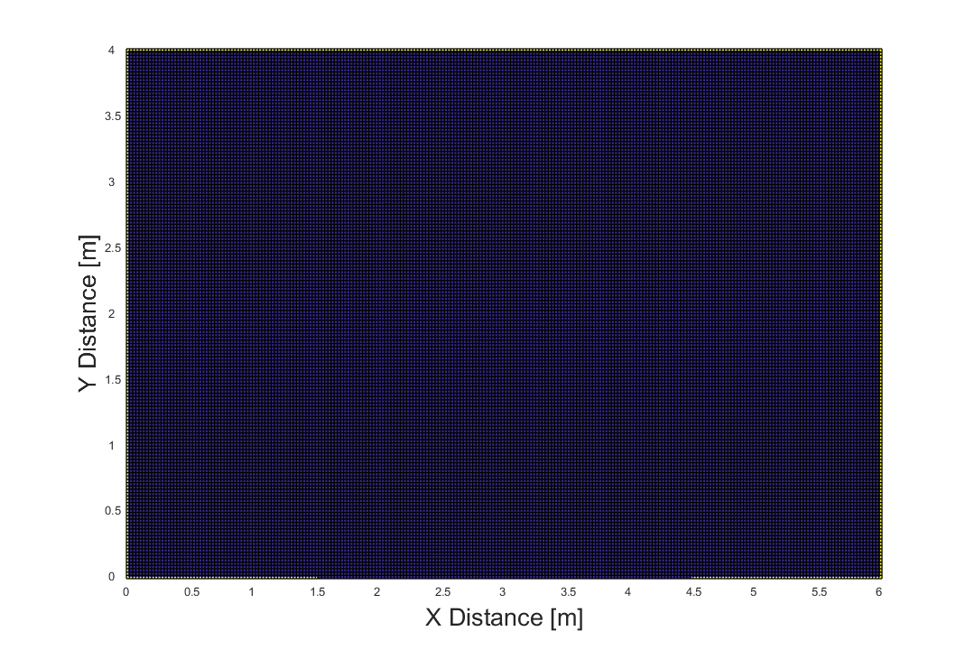
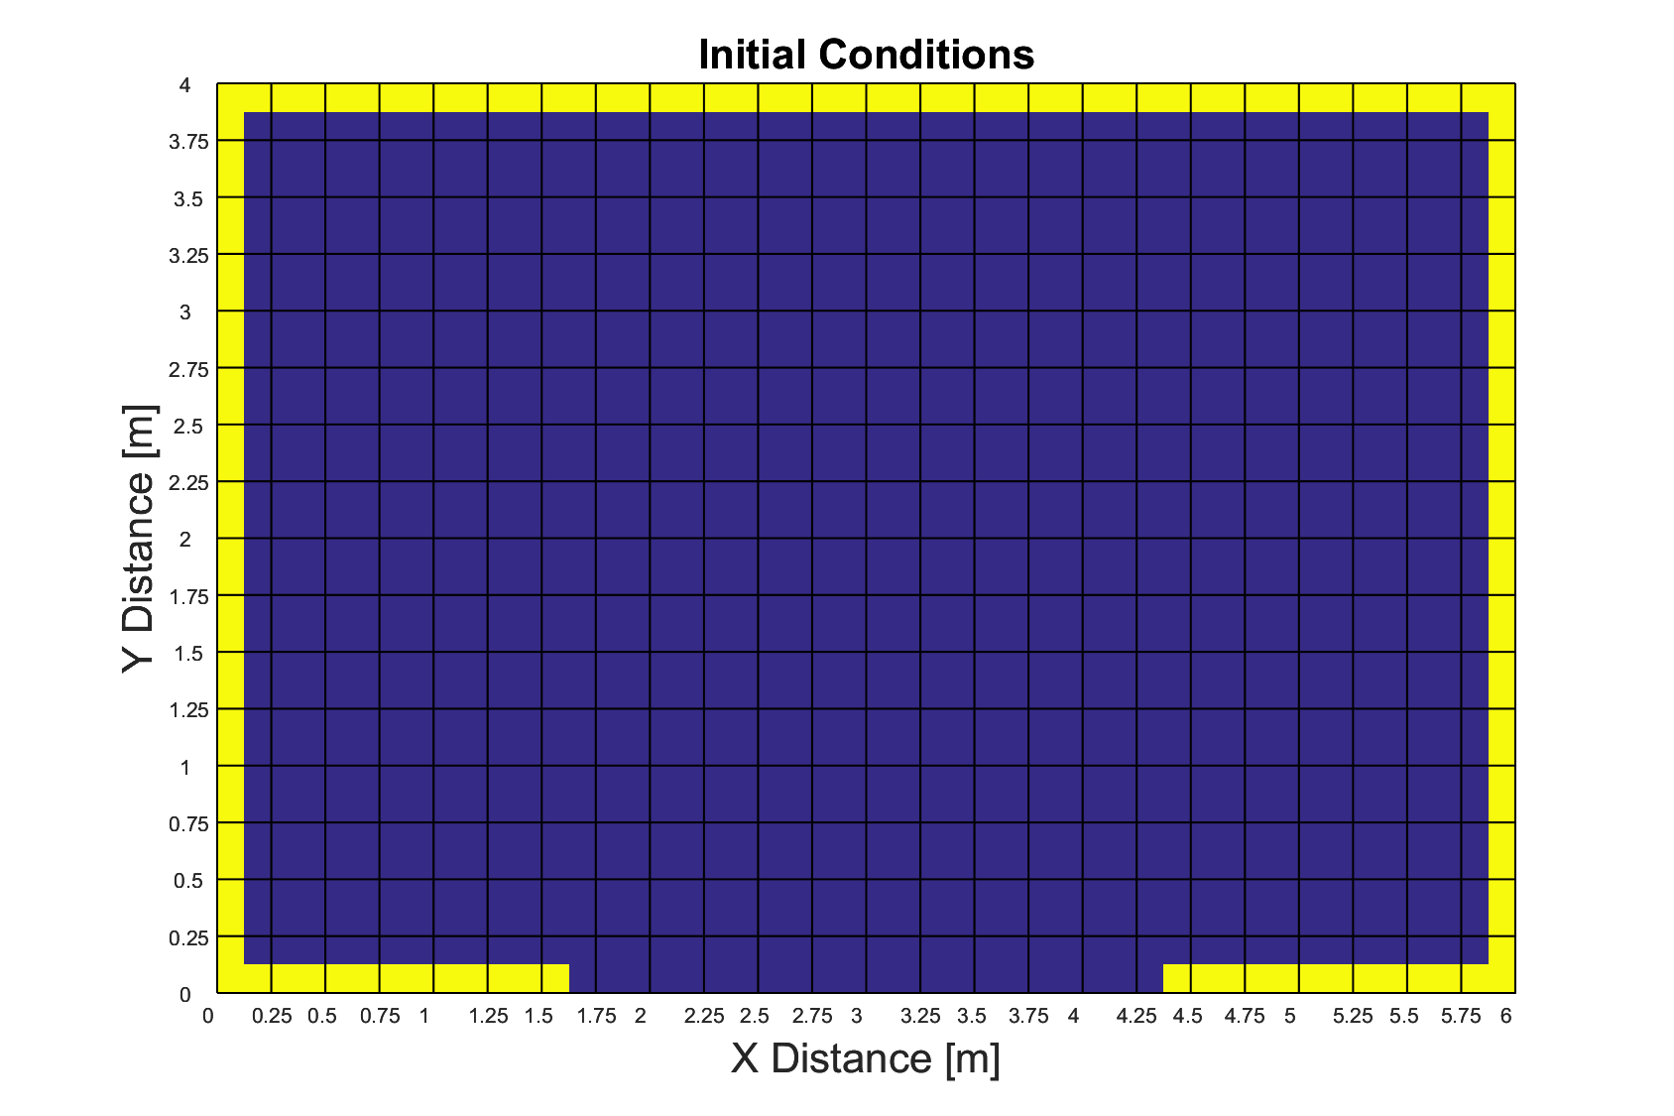
Initial Conditions
17 X 25 Mesh
161 X 241 Mesh

Slide 4
Small Mesh Error Comparison
Notes:
GS twice as fast a J

Slide 5
Small Mesh Error Comparison
ω = 1.24 for all cases
Notes:
SOR much slower than SLOR and ADI when unoptimized

Slide 6

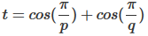
Small Mesh Error Comparison
[1]
ω = 1.24 for all cases
Optimized
ω_{Young}=1.7281
ω_{SOR}=1.725, ω_{SLOR}=1.2563, ω_{ADI}=1.295
[1] Young, D. (1954). Iterative methods for solving partial difference equations of elliptic type. College Park, Md.: Dept. of Mathematics, Univ. of Maryland.
Notes:
Tannehill book equation used to derive optimum over-relaxation factor

Slide 7
Large Mesh Error Comparison
Optimized
ω_{Young}=1.7281
ω_{SOR}=1.725, ω_{SLOR}=1.2563, ω_{ADI}=1.295

Slide 8
Wall Through Middle BC

Slide 9
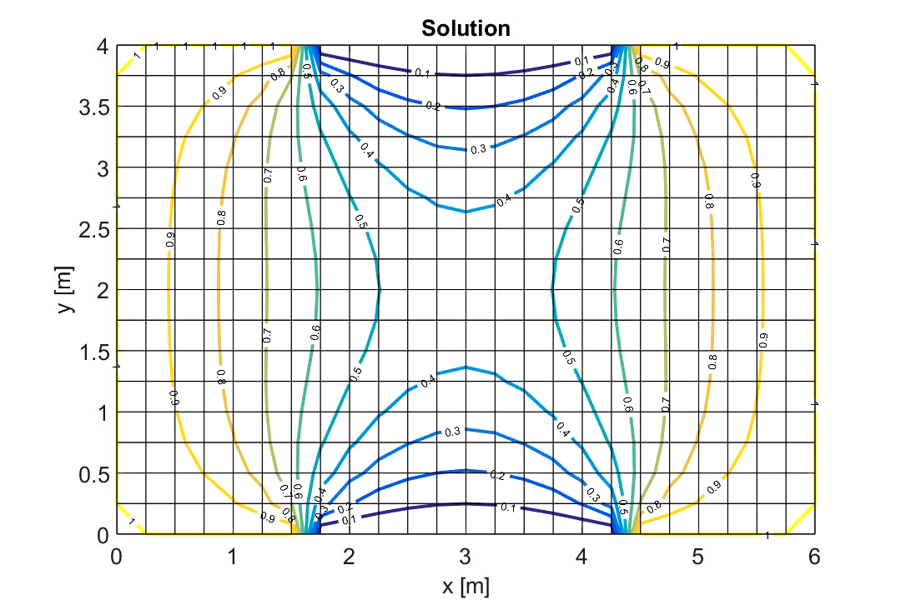
Slotted Wall BC at Different Locations

Slide 10
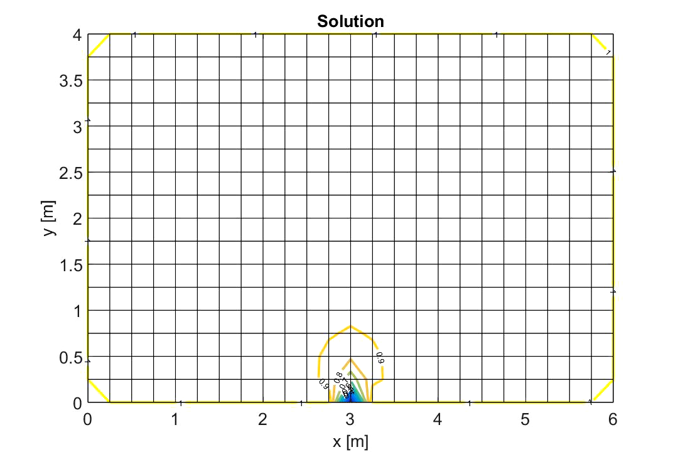
Sink Term at Different Locations

Slide 11
Questions?

